Slide 1
Computing Technology
Notes:
Reload codespace
Uncheck VS Code tabs

Slide 2
This is CS50
Do you have a rubber duck? 🦆 (if not ask after class)!
Today's snacks, ... 🐼 🍫

Slide 3

Notes:
https://www.youtube.com/watch?v=cZB_EBsnc8c

Slide 4
Computing Technology
Notes:
Reload codespace
Uncheck VS Code tabs

Slide 5
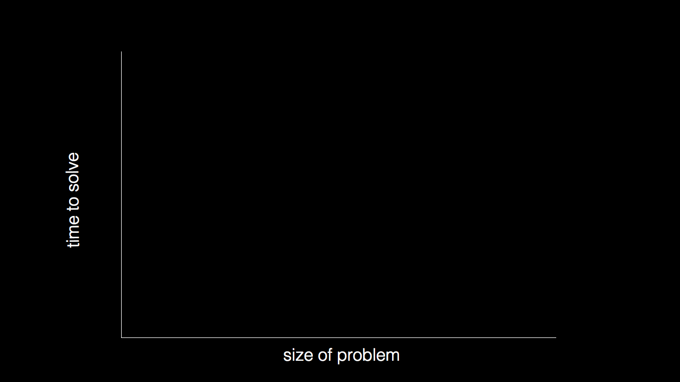

Slide 6
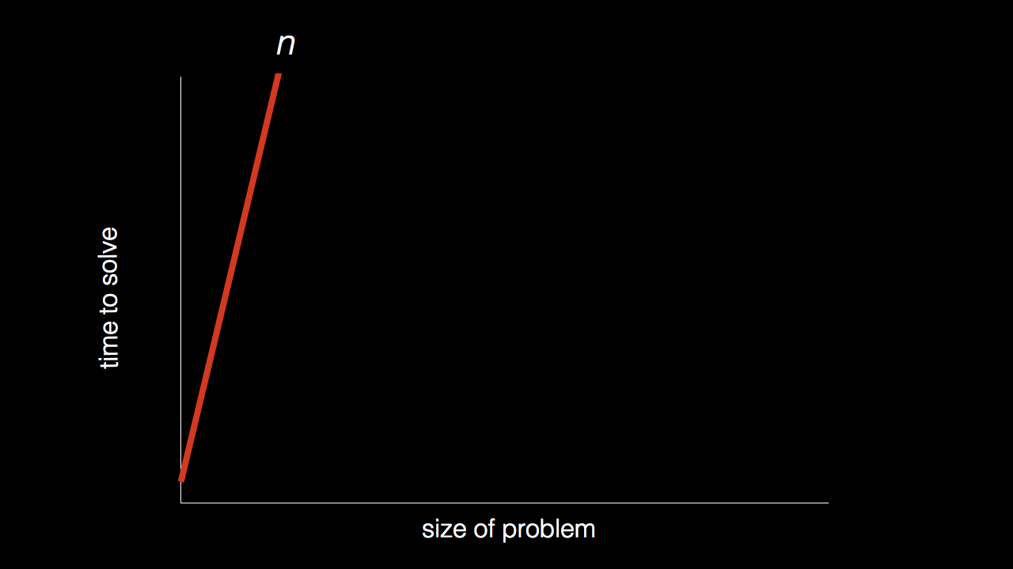
n

Slide 7
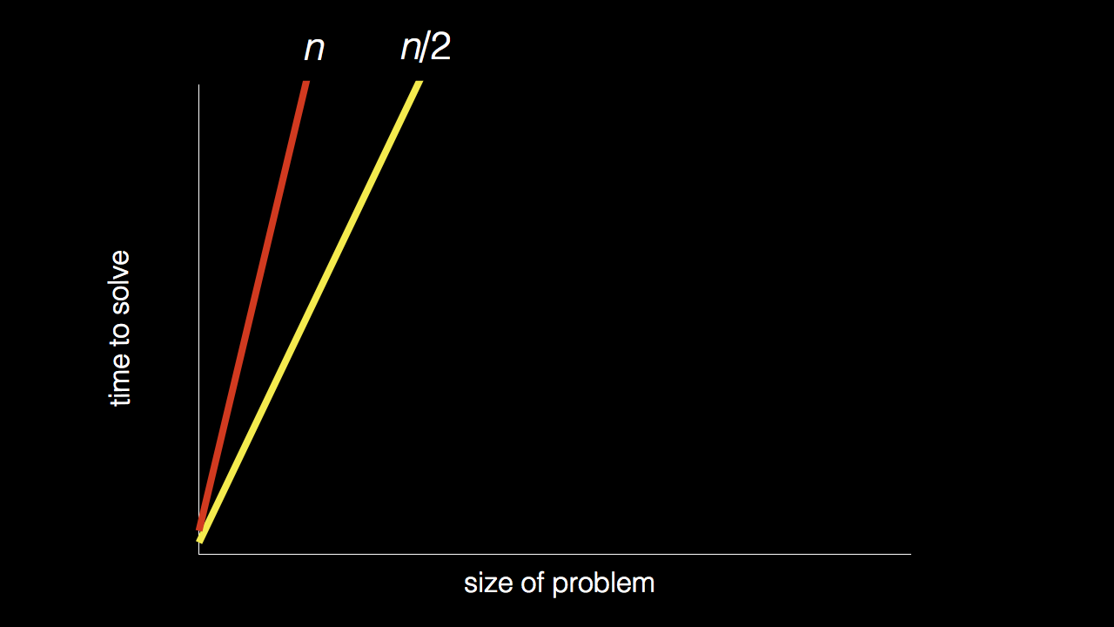
n
n/2

Slide 8
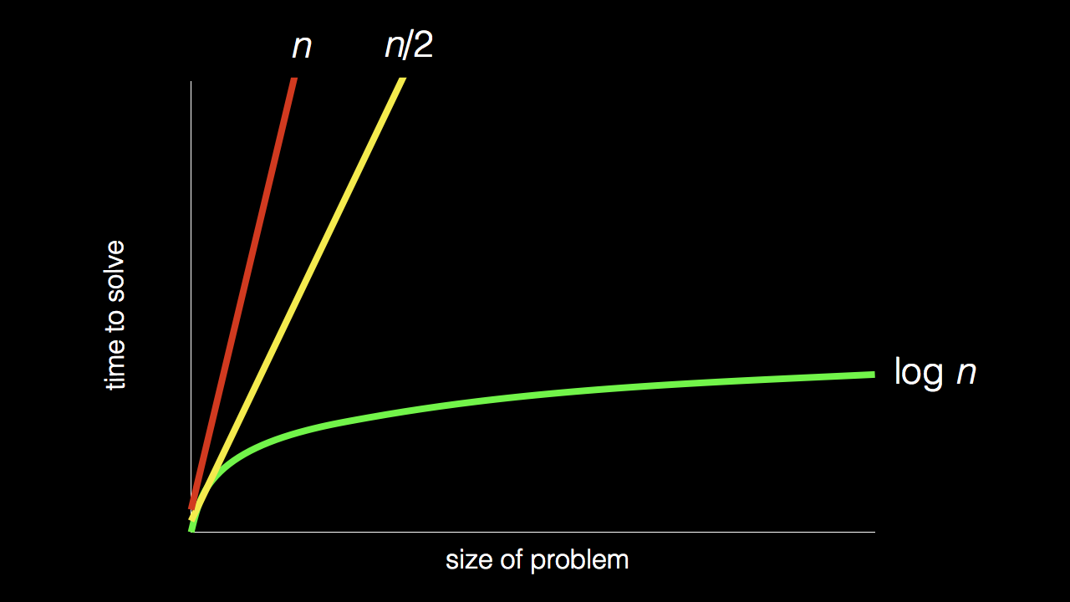
n
n/2
log₂ n

Slide 9
Stand up and think of the number 1.

Slide 10
Stand up and think of the number 1.
Pair off with someone standing, add their number to yours, and remember the sum.

Slide 11
Stand up and think of the number 1.
Pair off with someone standing, add their number to yours, and remember the sum.
One of you should then sit down.

Slide 12
Stand up and think of the number 1.
Pair off with someone standing, add their number to yours, and remember the sum.
One of you should then sit down.
If still standing, go back to step 2.

Slide 13

Notes:
https://apps.apple.com/us/app/contacts/id1069512615#?platform=iphone
In Week 0, intuitive algorithms…
John Harvard

Slide 14
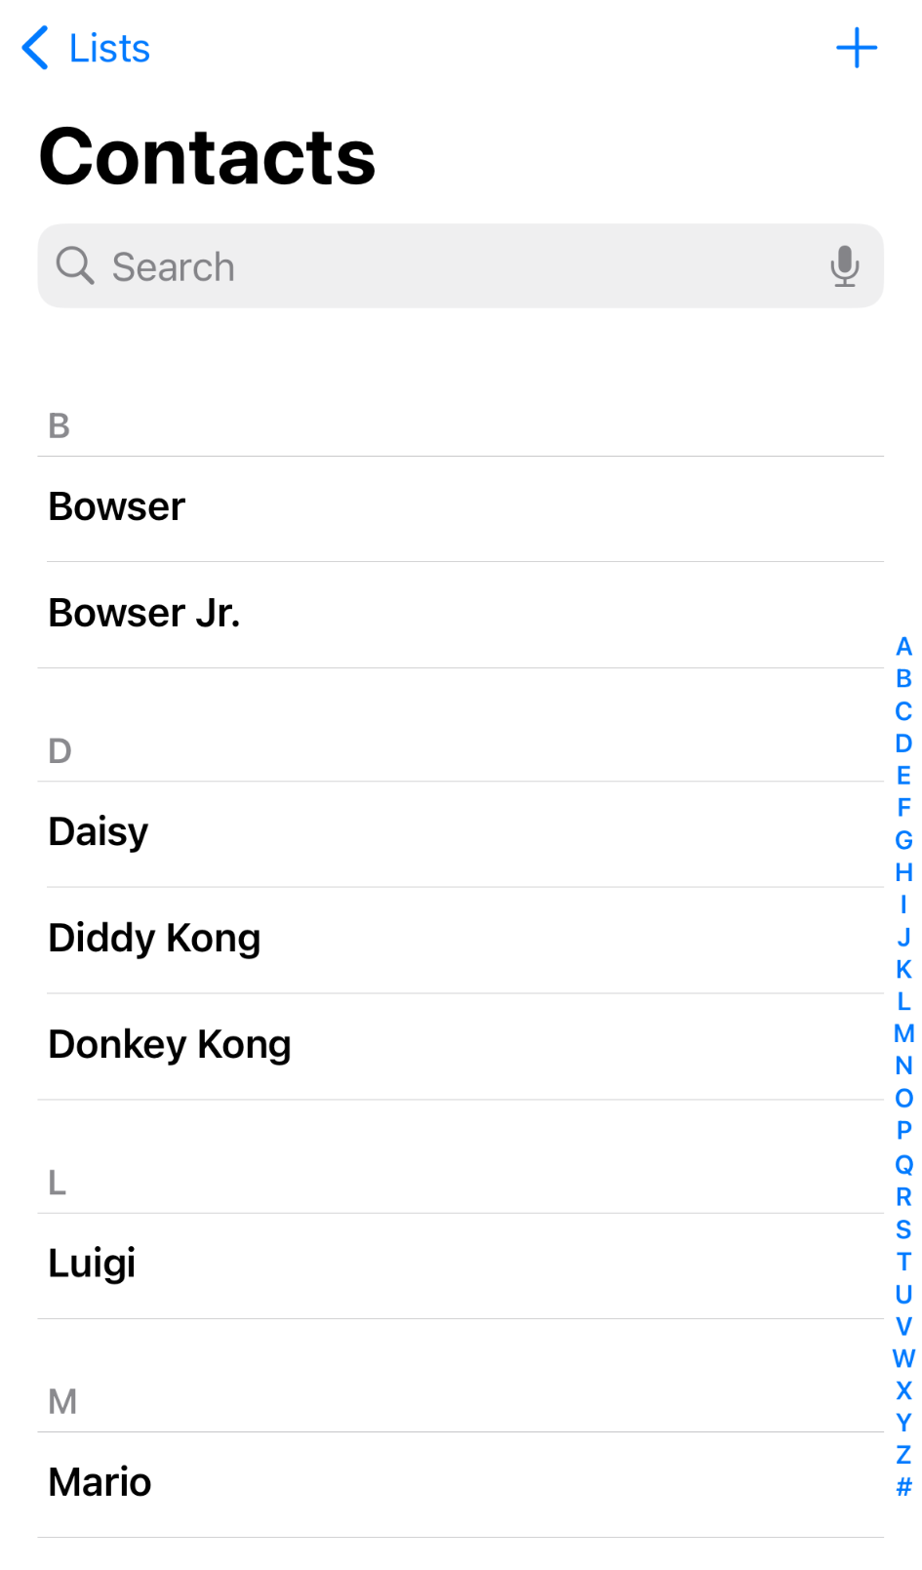
Notes:
https://nintendo.fandom.com/wiki/Nintendo_characters#Mario_series_(including_sub-franchises)

Slide 15
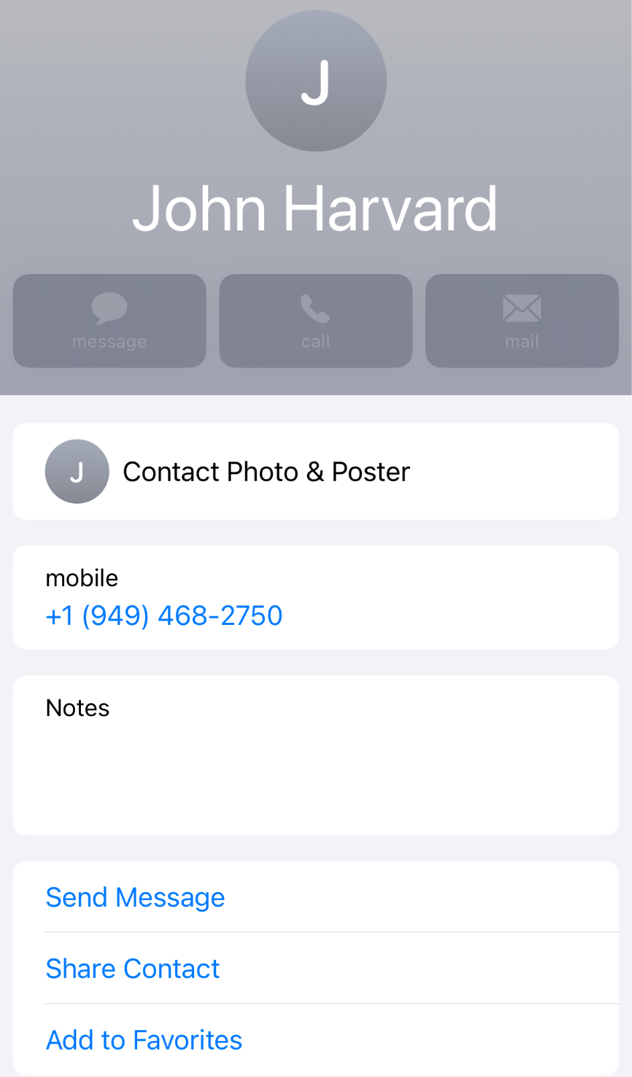

Slide 16
n

Slide 17
n
n/2

Slide 18
n
n/2
log₂ n

Slide 19
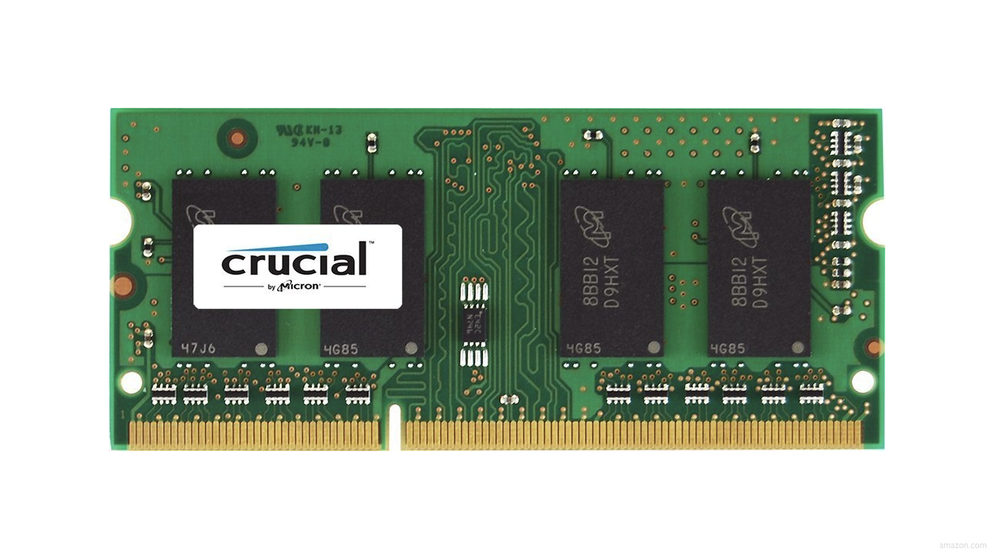

Slide 23
 | 1 | 5 | 10 | 20 | 50 | 100 | 500

Slide 25
 | [0] | [1] | [2] | [3] | [4] | [5] | [6]

Slide 26
 | [0] | [1] | [2] | [3] | [4] | [5] | [6]

Slide 27
searching

Slide 28
input →
→ output

Slide 29

→
→ output

Slide 30
→
→ bool

Slide 31
algorithm

Slide 32

Notes:
https://www.etsy.com/listing/926075105/monopoly-money-vintage-fabric-half-yard

Slide 33
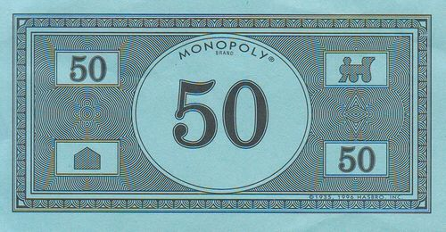
Notes:
https://www.pinterest.com/pin/525443481522247447/

Slide 34
linear search
Notes:
20 500 10 5 100 1 50

Slide 35
For each door from left to right
If 50 is behind door
Return true
Return false

Slide 36
For each door from left to right
If 50 is behind door
Return true
Else
Return false

Slide 37
For each door from left to right
If 50 is behind door
Return true
Return false

Slide 38
For i from 0 to n-1
If 50 is behind doors[i]
Return true
Return false

Slide 39
Notes:
https://www.pinterest.com/pin/525443481522247447/

Slide 40
binary search
Notes:
1 5 10 20 50 100 500

Slide 41
If 50 is behind middle door
Return true
Else if 50 < middle door
Search left half
Else if 50 > middle door
Search right half

Slide 42
If no doors left
If 50 is behind middle door
Return true
Else if 50 < middle door
Search left half
Else if 50 > middle door
Search right half

Slide 43
If no doors left
Return false
If 50 is behind middle door
Return true
Else if 50 < middle door
Search left half
Else if 50 > middle door
Search right half

Slide 44
If no doors left
Return false
If 50 is behind doors[middle]
Return true
Else if 50 < doors[middle]
Search doors[0] through doors[middle - 1]
Else if 50 > doors[middle]
Search doors[middle + 1] through doors[n - 1]

Slide 45
running time

Slide 46
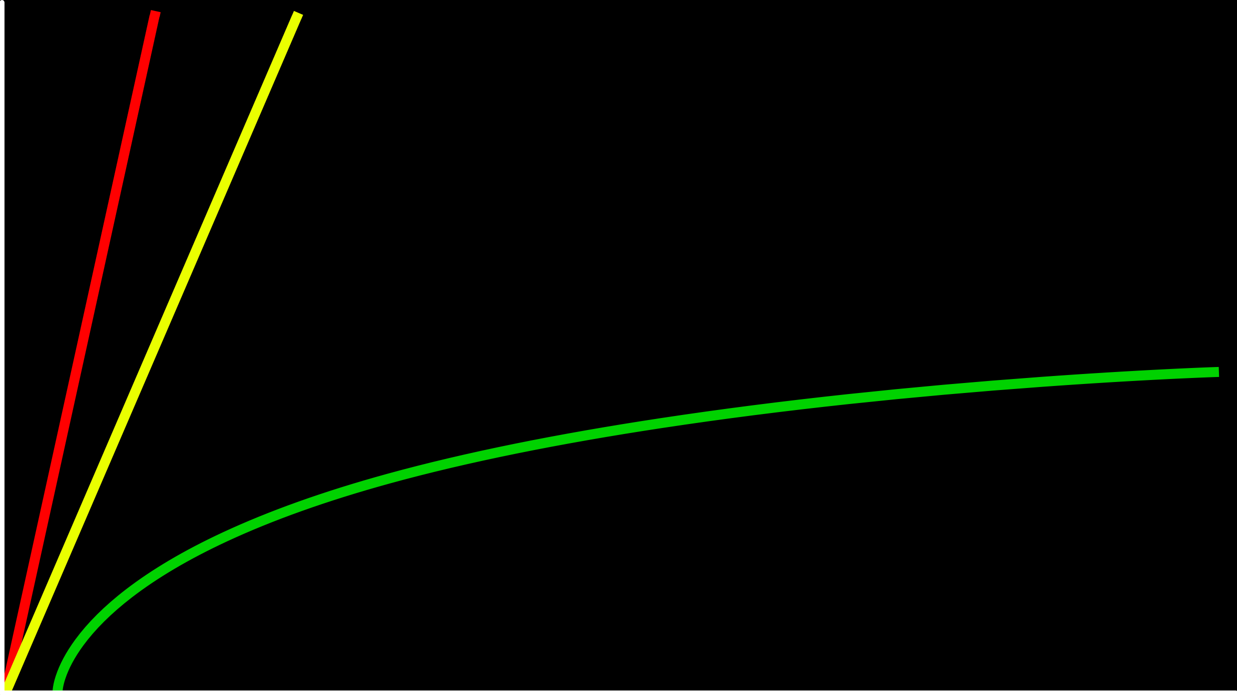
time to solve
size of problem

Slide 47
O(n)
O(n/2)
time to solve
O(log₂n)
size of problem

Slide 48
O(n)
O(n/2)
time to solve
O(log₂n)
size of problem

Slide 49
O(n)
O(n)
time to solve
O(log₂n)
size of problem

Slide 50
O(n)
O(n)
time to solve
O(log n)
size of problem

Slide 51
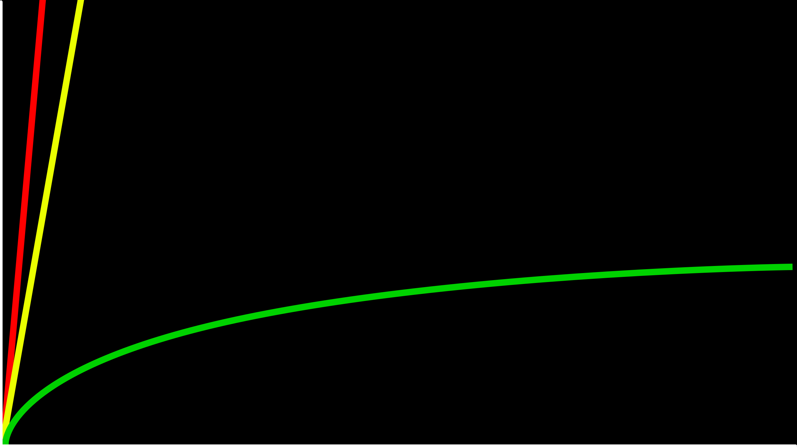
O(n)
time to solve
O(log n)
size of problem

Slide 52
O

Slide 53
O(n²)
O(n log n)
O(n)
O(log n)
O(1)
Notes:
linear? binary?

Slide 54
O(n²)
O(n log n)
O(n) linear search
O(log n)
O(1)

Slide 55
O(n²)
O(n log n)
O(n) linear search
O(log n) binary search
O(1)

Slide 56
Ω

Slide 57
Ω(n²)
Ω(n log n)
Ω(n)
Ω(log n)
Ω(1)
Notes:
linear? binary?

Slide 58
Ω(n²)
Ω(n log n)
Ω(n)
Ω(log n)
Ω(1) linear search

Slide 59
Ω(n²)
Ω(n log n)
Ω(n)
Ω(log n)
Ω(1) linear search, binary search

Slide 60
Θ

Slide 61
Θ(n²)
Θ(n log n)
Θ(n)
Θ(log n)
Θ(1)

Slide 62
asymptotic notation
Notes:
search{0,1}.c

Slide 63
linear search
Notes:
search{0,1}.c

Slide 64
string.h

Slide 65
manual.cs50.io/#string.h

Slide 66
strcmp
Notes:
phonebook0.c

Slide 67
data structures

Slide 68
person people[]

Slide 69
string name;
string number;

Slide 70
typedef struct
{
string name;
string number;
}
person;

Slide 71
typedef struct
{
string name;
string number;
} person;
Notes:
phonebook1.c
we'll see a way to save phonebook eventually

Slide 72
sorting

Slide 73
input →
→ output

Slide 74
unsorted →
→ output

Slide 75
unsorted →
→ sorted

Slide 76
→
→ sorted
7 2 5 4 1 6 0 3

Slide 77
→
→
7 2 5 4 1 6 0 3
0 1 2 3 4 5 6 7

Slide 78
7 2 5 4 1 6 0 3
Notes:
volunteers: sort themselves, then selection, then bubble

Slide 79
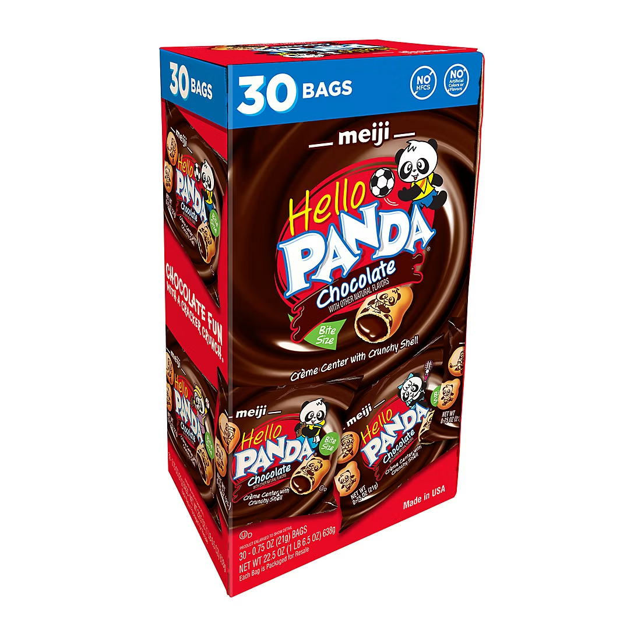

Slide 80
selection sort
Notes:
https://www.cs.usfca.edu/~galles/visualization/ComparisonSort.html

Slide 81
 | [0] | [1] | [2] | ... | [n-3] | [n-2] | [n-1]

Slide 82
For i from 0 to n-1
Find smallest number between numbers[i] and numbers[n-1]
Swap smallest number with numbers[i]

Slide 83
7 2 5 4 1 6 0 3

Slide 84
7 2 5 4 1 6 0 3
[i]

Slide 85
7 2 5 4 1 6 0 3
[i]
[i]
[n-1]

Slide 86
7 2 5 4 1 6 0 3
[i]
[i]
[n-1]

Slide 87
7 2 5 4 1 6 0 3
[i]
[i]
[n-1]

Slide 88
7 2 5 4 1 6 0 3
[i]
[i]
[n-1]

Slide 89
7 2 5 4 1 6 0 3
[i]
[i]
[n-1]

Slide 90
7 2 5 4 1 6 0 3
[i]
[i]
[n-1]

Slide 91
0 2 5 4 1 6 7 3
[i]
[i]
[n-1]

Slide 92
0 2 5 4 1 6 7 3
[i]
[i]
[n-1]

Slide 93
0 2 5 4 1 6 7 3
[i]
[i]
[n-1]

Slide 94
0 2 5 4 1 6 7 3
[i]
[n-1]

Slide 95
(n – 1)

Slide 96
(n – 1) + (n – 2)

Slide 97
(n – 1) + (n – 2) + (n – 3)

Slide 98
(n – 1) + (n – 2) + (n – 3) + ... + 1

Slide 99
(n – 1) + (n – 2) + (n – 3) + ... + 1
n(n – 1)/2

Slide 100
(n – 1) + (n – 2) + (n – 3) + ... + 1
n(n – 1)/2
(n² – n)/2

Slide 101
(n – 1) + (n – 2) + (n – 3) + ... + 1
n(n – 1)/2
(n² – n)/2
n²/2 – n/2

Slide 102
(n – 1) + (n – 2) + (n – 3) + ... + 1
n(n – 1)/2
(n² – n)/2
n²/2 – n/2
O(n²)

Slide 103
O(n²)
O(n log n)
O(n)
O(log n)
O(1)

Slide 104
O(n²) selection sort
O(n log n)
O(n)
O(log n)
O(1)

Slide 105
For i from 0 to n-1
Find smallest number between numbers[i] and numbers[n-1]
Swap smallest number with numbers[i]
Notes:
what about lower bound?

Slide 106
 | [0] | [1] | [2] | ... | [n-3] | [n-2] | [n-1]

Slide 107
Ω(n²)
Ω(n log n)
Ω(n)
Ω(log n)
Ω(1)

Slide 108
Ω(n²) selection sort
Ω(n log n)
Ω(n)
Ω(log n)
Ω(1)

Slide 109
Θ(n²)
Θ(n log n)
Θ(n)
Θ(log n)
Θ(1)

Slide 110
Θ(n²) selection sort
Θ(n log n)
Θ(n)
Θ(log n)
Θ(1)

Slide 111
bubble sort
Notes:
https://www.cs.usfca.edu/~galles/visualization/ComparisonSort.html

Slide 112
 | [0] | [1] | [2] | ... | [n-3] | [n-2] | [n-1]

Slide 113
Repeat n times
For i from 0 to n-2
If numbers[i] and numbers[i+1] out of order
Swap them

Slide 114
Repeat n-1 times
For i from 0 to n-2
If numbers[i] and numbers[i+1] out of order
Swap them

Slide 115
7 2 5 4 1 6 0 3

Slide 116
7 2 5 4 1 6 0 3
[i] [i+1]

Slide 117
2 7 5 4 1 6 0 3
[i] [i+1]

Slide 118
2 7 5 4 1 6 0 3
[i] [i+1]

Slide 119
2 5 7 4 1 6 0 3
[i] [i+1]

Slide 120
2 5 7 4 1 6 0 3
[i] [i+1]

Slide 121
2 5 4 7 1 6 0 3
[i] [i+1]

Slide 122
2 5 4 7 1 6 0 3
[i] [i+1]

Slide 123
2 5 4 1 7 6 0 3
[i] [i+1]

Slide 124
2 5 4 1 7 6 0 3
[i] [i+1]

Slide 125
2 5 4 1 6 7 0 3
[i] [i+1]

Slide 126
2 5 4 1 6 7 0 3
[i] [i+1]

Slide 127
2 5 4 1 6 0 7 3
[i] [i+1]

Slide 128
2 5 4 1 6 0 7 3
[i] [i+1]

Slide 129
2 5 4 1 6 0 3 7
[i] [i+1]

Slide 130
2 5 4 1 6 0 3 7
[i] [i+1]

Slide 131
Repeat n-1 times
For i from 0 to n-2
If numbers[i] and numbers[i+1] out of order
Swap them

Slide 132
Repeat n-1 times n-1
For i from 0 to n-2
If numbers[i] and numbers[i+1] out of order
Swap them

Slide 133
Repeat n-1 times n-1
For i from 0 to n-2 n-1
If numbers[i] and numbers[i+1] out of order
Swap them

Slide 134
Repeat n-1 times n-1
For i from 0 to n-2 n-1
If numbers[i] and numbers[i+1] out of order 1
Swap them

Slide 135
Repeat n-1 times n-1
For i from 0 to n-2 n-1
If numbers[i] and numbers[i+1] out of order 4
Swap them

Slide 136
Repeat n-1 times n-1
For i from 0 to n-2 n-1
If numbers[i] and numbers[i+1] out of order
Swap them

Slide 137
(n – 1) × (n – 1)

Slide 138
(n – 1) × (n – 1)
n² – 1n – 1n + 1

Slide 139
(n – 1) × (n – 1)
n² – 1n – 1n + 1
n² – 2n + 1

Slide 140
(n – 1) × (n – 1)
n² – 1n – 1n + 1
n² – 2n + 1
O(n²)

Slide 141
O(n²)
O(n log n)
O(n)
O(log n)
O(1)

Slide 142
O(n²) bubble sort
O(n log n)
O(n)
O(log n)
O(1)

Slide 143
Repeat n-1 times
For i from 0 to n-2
If numbers[i] and numbers[i+1] out of order
Swap them

Slide 144
Repeat n-1 times
For i from 0 to n-2
If numbers[i] and numbers[i+1] out of order
Swap them
If no swaps
Quit

Slide 145
Ω(n²)
Ω(n log n)
Ω(n)
Ω(log n)
Ω(1)

Slide 146
Ω(n²)
Ω(n log n)
Ω(n) bubble sort
Ω(log n)
Ω(1)

Slide 147
recursion

Slide 148
If no doors left
Return false
If number behind middle door
Return true
Else if number < middle door
Search left half
Else if number > middle door
Search right half

Slide 149
If no doors left
Return false
If number behind middle door
Return true
Else if number < middle door
Search left half
Else if number > middle door
Search right half

Slide 150
1 Pick up phone book
2 Open to middle of phone book
3 Look at page
4 If person is on page
5 Call person
6 Else if person is earlier in book
7 Open to middle of left half of book
8 Go back to line 3
9 Else if person is later in book
10 Open to middle of right half of book
11 Go back to line 3
12 Else
13 Quit

Slide 151
1 Pick up phone book
2 Open to middle of phone book
3 Look at page
4 If person is on page
5 Call person
6 Else if person is earlier in book
7 Open to middle of left half of book
8 Go back to line 3
9 Else if person is later in book
10 Open to middle of right half of book
11 Go back to line 3
12 Else
13 Quit

Slide 152
1 Pick up phone book
2 Open to middle of phone book
3 Look at page
4 If person is on page
5 Call person
6 Else if person is earlier in book
7 Open to middle of left half of book
8 Go back to line 3
9 Else if person is later in book
10 Open to middle of right half of book
11 Go back to line 3
12 Else
13 Quit

Slide 153
1 Pick up phone book
2 Open to middle of phone book
3 Look at page
4 If person is on page
5 Call person
6 Else if person is earlier in book
7 Search left half of book
8
9 Else if person is later in book
10 Search right half of book
11
12 Else
13 Quit

Slide 154
1 Pick up phone book
2 Open to middle of phone book
3 Look at page
4 If person is on page
5 Call person
6 Else if person is earlier in book
7 Search left half of book
8 Else if person is later in book
9 Search right half of book
10 Else
11 Quit

Slide 155

Notes:
http://ian-albert.com/games/super_mario_bros_maps/

Slide 156

Notes:
iteration.c

Slide 157


Slide 158


Slide 159


Slide 160

Notes:
recursion.c

Slide 161
google.com/search?q=recursion

Slide 162
merge sort

Slide 163
Sort left half of numbers
Sort right half of numbers
Merge sorted halves

Slide 164
If only one number
Quit
Else
Sort left half of numbers
Sort right half of numbers
Merge sorted halves

Slide 165
If only one number
Quit
Else
Sort left half of numbers
Sort right half of numbers
Merge sorted halves

Slide 166
1 3 4 6 0 2 5 7
Notes:
shelves

Slide 167
If only one number
Quit
Else
Sort left half of numbers
Sort right half of numbers
Merge sorted halves
Notes:
https://www.cs.usfca.edu/~galles/visualization/ComparisonSort.html

Slide 168
6 3 4 1 5 2 7 0
Notes:
shelves

Slide 169
6 | 3 | 4 | 1 | 5 | 2 | 7 | 0

Slide 170
6 | 3 | 4 | 1 | 5 | 2 | 7 | 0

Slide 171
 |  |  |  | 5 | 2 | 7 | 0
6 | 3 | 4 | 1

Slide 172
 |  |  |  | 5 | 2 | 7 | 0
 |  | 4 | 1
6 | 3

Slide 173
 |  |  |  | 5 | 2 | 7 | 0
 |  | 4 | 1
 | 3
6

Slide 174
 |  |  |  | 5 | 2 | 7 | 0
 |  | 4 | 1
6
3

Slide 175
 |  |  |  | 5 | 2 | 7 | 0
 |  | 4 | 1
3
6

Slide 176
 |  |  |  | 5 | 2 | 7 | 0
 |  | 4 | 1
3 | 6

Slide 177
 |  |  |  | 5 | 2 | 7 | 0
3 | 6
4 | 1

Slide 178
 |  |  |  | 5 | 2 | 7 | 0
3 | 6
 | 1
4

Slide 179
 |  |  |  | 5 | 2 | 7 | 0
3 | 6
4
1

Slide 180
 |  |  |  | 5 | 2 | 7 | 0
3 | 6
1
4

Slide 181
 |  |  |  | 5 | 2 | 7 | 0
3 | 6
1 | 4

Slide 182
 |  |  |  | 5 | 2 | 7 | 0
1
3 | 6
 | 4

Slide 183
 |  |  |  | 5 | 2 | 7 | 0
1 | 3
 | 6
 | 4

Slide 184
 |  |  |  | 5 | 2 | 7 | 0
1 | 3 | 4
 | 6

Slide 185
 |  |  |  | 5 | 2 | 7 | 0
1 | 3 | 4 | 6

Slide 186
1 | 3 | 4 | 6
5 | 2 | 7 | 0

Slide 187
1 | 3 | 4 | 6
 |  | 7 | 0
5 | 2

Slide 188
1 | 3 | 4 | 6
 |  | 7 | 0
 | 2
5

Slide 189
1 | 3 | 4 | 6
 |  | 7 | 0
5
2

Slide 190
1 | 3 | 4 | 6
 |  | 7 | 0
2
5

Slide 191
1 | 3 | 4 | 6
 |  | 7 | 0
2 | 5

Slide 192
1 | 3 | 4 | 6
2 | 5
7 | 0

Slide 193
1 | 3 | 4 | 6
2 | 5
 | 0
7

Slide 194
1 | 3 | 4 | 6
2 | 5
7
0

Slide 195
1 | 3 | 4 | 6
2 | 5
0
7

Slide 196
1 | 3 | 4 | 6
2 | 5
0 | 7

Slide 197
1 | 3 | 4 | 6
0
2 | 5
 | 7

Slide 198
1 | 3 | 4 | 6
0 | 2
 | 5
 | 7

Slide 199
1 | 3 | 4 | 6
0 | 2 | 5
 | 7

Slide 200
1 | 3 | 4 | 6
0 | 2 | 5 | 7

Slide 201
0
1 | 3 | 4 | 6
 | 2 | 5 | 7

Slide 202
0 | 1
 | 3 | 4 | 6
 | 2 | 5 | 7

Slide 203
0 | 1 | 2
 | 3 | 4 | 6
 |  | 5 | 7

Slide 204
0 | 1 | 2 | 3
 |  | 4 | 6
 |  | 5 | 7

Slide 205
0 | 1 | 2 | 3 | 4
 |  |  | 6
 |  | 5 | 7

Slide 206
0 | 1 | 2 | 3 | 4 | 5
 |  |  | 6
 |  |  | 7

Slide 207
0 | 1 | 2 | 3 | 4 | 5 | 6
 |  |  | 7

Slide 208
0 | 1 | 2 | 3 | 4 | 5 | 6 | 7

Slide 209
0 | 1 | 2 | 3 | 4 | 5 | 6 | 7

Slide 210
O(n²)
O(n log n)
O(n)
O(log n)
O(1)

Slide 211
6 | 3 | 4 | 1 | 5 | 2 | 7 | 0
6 | 3 | 4 | 1
5 | 2 | 7 | 0
6 | 3
4 | 1
5 | 2
7 | 0
6
3
4
1
5
2
7
0

Slide 212
6 | 3 | 4 | 1 | 5 | 2 | 7 | 0
6 | 3 | 4 | 1
5 | 2 | 7 | 0
6 | 3
4 | 1
5 | 2
7 | 0
6
3
4
1
5
2
7
0

Slide 213
log₂ n

Slide 214
log₂ 8

Slide 215
log₂ 2³

Slide 216
3

Slide 217
6 | 3 | 4 | 1 | 5 | 2 | 7 | 0
6 | 3 | 4 | 1
5 | 2 | 7 | 0
6 | 3
4 | 1
5 | 2
7 | 0
6
3
4
1
5
2
7
0

Slide 218
n log₂ n

Slide 219
n log n

Slide 220
O(n²)
O(n log n) merge sort
O(n)
O(log n)
O(1)

Slide 221
Ω(n²)
Ω(n log n) merge sort
Ω(n)
Ω(log n)
Ω(1)

Slide 222
Θ(n²)
Θ(n log n) merge sort
Θ(n)
Θ(log n)
Θ(1)

Slide 223
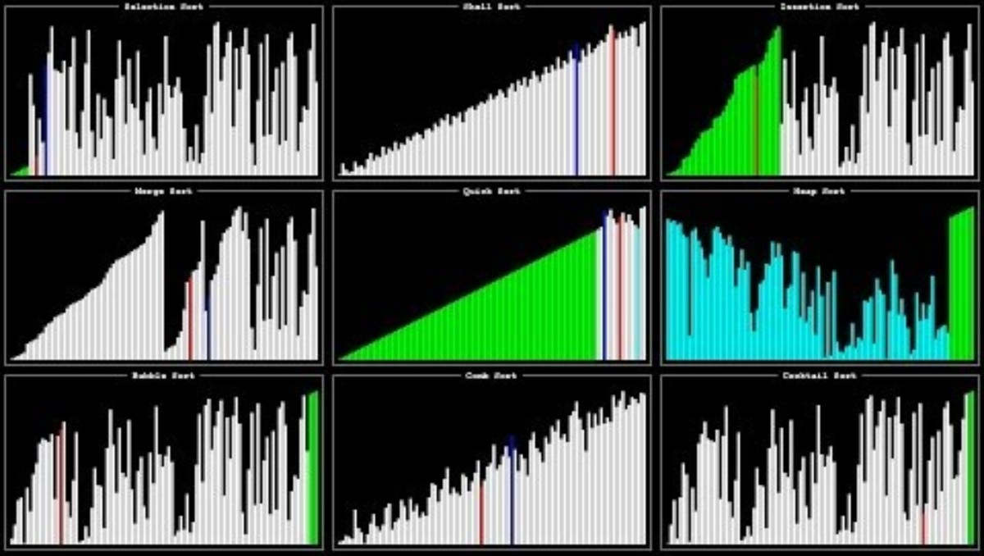
Notes:
Source: https://www.youtube.com/watch?v=ZZuD6iUe3Pc
https://www.youtubeeducation.com/watch?v=3WDWH59k1q4

Slide 224
Computing Technology
Notes:
Reload codespace
Uncheck VS Code tabs

